Slide 1


Python Programming Ⅰ
week 1

Slide 2
수업 목표
‘좋은 프로그램’이란?
문제를 해결할 것
Computational thinking
알고리즘 & 프로토콜 창안, 구현 능력
유지보수가 쉬울 것
가독성 (readability)
대칭성 (symmetricity)
중복(duplication) 배제
간결성
코드 다울 것
문제해결
유지보수
+ 미학적 특성

Slide 3
알고리즘이란?
사용 가능한 기능을 활용하여
“기능 목록”
주어진 제약조건을 만족하면서
“제약조건 목록”
목표를 달성하는
“목표”
과정을 설계하여 표현한 것
“창안, 설계, 구현”

Slide 4
Topic Structure
Task | Single Value | Multiple Values | numpy, pandas
Presentation (value, variable) | int, float, string, boolean | list, tuple, dictionary, set | ndarray, Series, DataFrame
Operation (algebra) | expressions | operations, mutable operations | expressions, get, set, reshape, …
Control flow | if for while
Use and reuse | Functions Standard libraries Modules and Packages
Input and output | Standard I/O File I/O |  | Standard I/O File I/O CSV, Excel

Slide 5
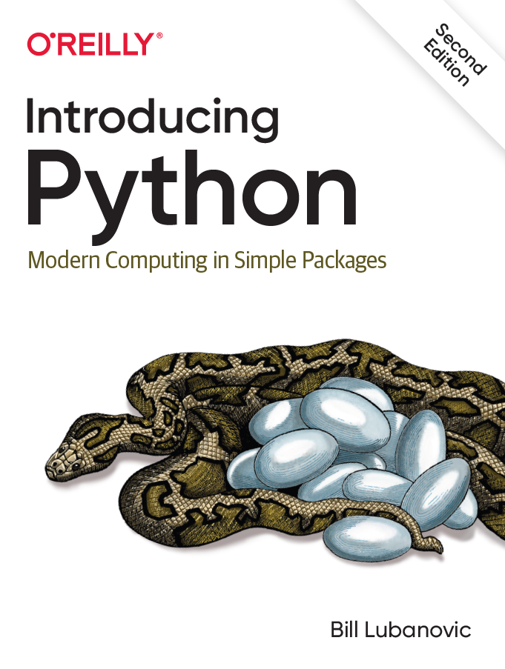
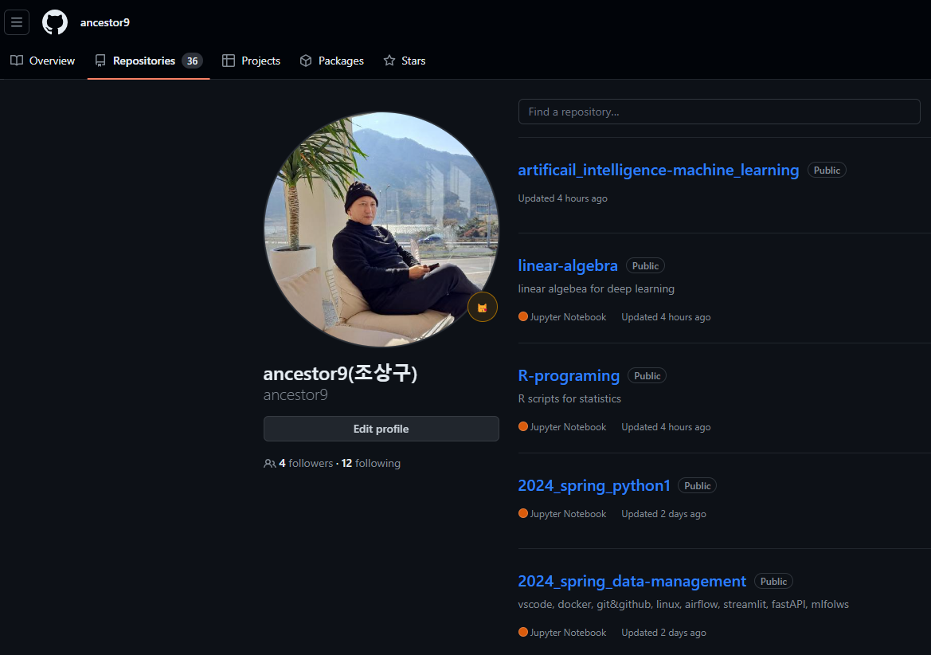
Texts & References
https://github.com/madscheme/introducing-python
https://github.com/ancestor9/2024_spring_python1

Slide 6
Goals
Installation of Python
Microsoft’ vs code
Virtual Environment
Jupyter Notebook (IPython)
Co-lab with google driver

Slide 7
Symbol Names
 | Name |  | Name
~ | Tilde | ' | Single quotation mark, Apostrophe
` | Grave | " | Double quotation mark
! | Exclamation mark | / | Slash, Virgule
@ | At sign, Commercial at | \ | Back slash
# | Number sign, Crosshatch, Pound sign | | | Vertical bar
$ | Dollar sign | , | Comma
% | Percent sign | . | Dot, Period, Full stop
^ | Hat sign, Circumflex | ? | Question mark
& | Ampersand | ( ) | (Left / Right) parenthesis
* | Asterisk, Star sign | { } | (Left / Right) braces, curved parenthesis
– | Dash, Hyphen, Minus sign | [ ] | (Left / Right) bracket, squared parenthesis
_ | Underscore, Underline | < > | (Left / Right) angle bracket, pointed brackets
+ | Plus sign | ⇦ ⇨ | (Left / Right) [unidirectional] arrows
= | Equal sign | ⬄ | Bidirectional arrow
: | Colon
; | Semicolon

Slide 8
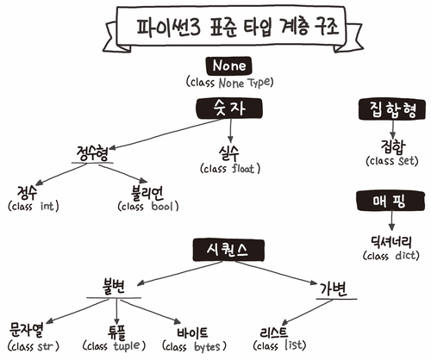
https://velog.io/@jaybon/%ED%8C%8C%EC%9D%B4%EC%8D%AC-%ED%83%80%EC%9E%85

Slide 9
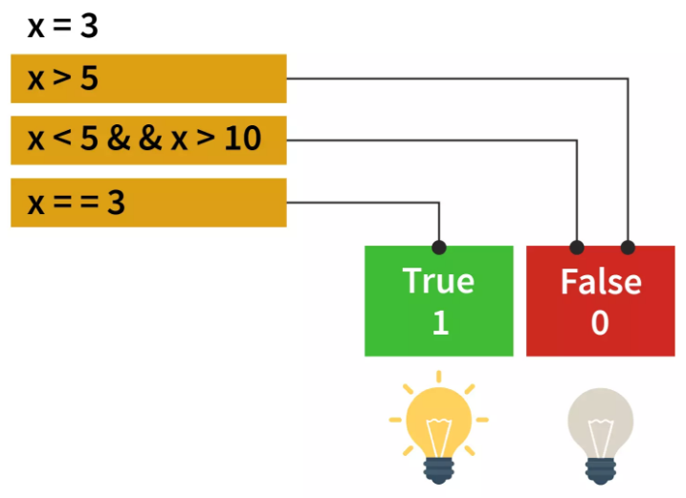
Python operation & expression
3 은 literal value(constant)
x 는 variable
==는 Boolean Operator
+, -, /, **, //, % 는 arithmetic operators
x == 3 은 Boolean Expression
https://scaler.com/topics/images/python-boolean-operators.webp

Slide 10
Python: Basics
Notes:
안녕하세요, 조상구입니다.
이 동영상에서는 Python Basic을 주제로 배워 보겠습니다.

Slide 11
Topic Structure
Task | Single Value | Multiple Values | numpy, pandas
Presentation (value, variable) | int, float, string, boolean | list, tuple, dictionary, set | ndarray, Series, DataFrame
Operation (algebra) | expressions | operations, mutable operations | expressions, get, set, reshape, …
Control flow | if for while
Use and reuse | Functions Standard libraries Modules and Packages
Input and output | Standard I/O File I/O |  | Standard I/O File I/O CSV, Excel

Slide 12
Learning Objectives
Comments
Literal Constants
Numbers, Strings, Boolean types
format Method
Escape Sequence
Variables
Indentation

Slide 13
Comments
Comments are any text to the right of the # symbol and is mainly useful as notes for the reader of the program.
e.g.
print('hello world') # Note that print is a function
e.g.
# Note that print is a function
print('hello world')

Slide 14
Example: Comments
# comment 1
print("hello, world") # comment 2
# comment 3

Slide 15
Comments
Use as many useful comments as you can in your program to:
explain assumptions
explain important decisions
explain important details
explain problems you're trying to solve
explain problems you're trying to overcome in your program, etc.
"Code tells you how, comments should tell you why."
5W1H: When, where, who, what, why, and how

Slide 16
Learning Objectives
Comments
Literal Constants
Numbers, Strings, Boolean types
format Method
Escape Sequence
Variables
Indentation

Slide 17
Literal Constants
Types of literal constants
Numbers
2
1.23
Strings
'This is a string'
"It's a string!"
Boolean types
True (equivalent to 1)
False (equivalent to 0)
The number 2 always represents itself and nothing else - it is a constant because its value cannot be changed.
Hence, all these are referred to as literal constants.

Slide 18
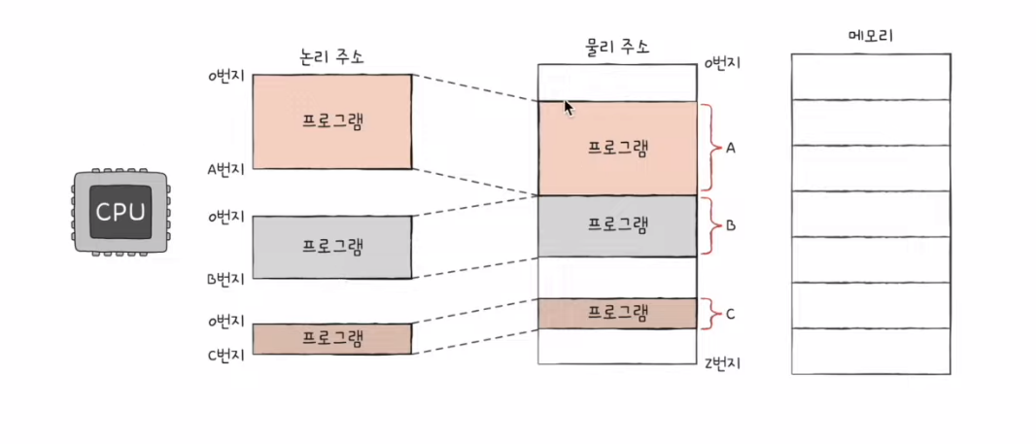
Example: Literal Constants
print("hello, world")
print(hello, world)
print(True)
print(true)
print(id(1))
print(id(2))
https://velog.velcdn.com/images/kong2520/post/9e5b7033-1ca2-48d6-9b54-77105c4b05a9/image.png

Slide 19
Numbers
Integers
2
Floats
1.23
52.3E-4
The ‘E notation’ indicates powers of 10.
In this case, 52.3E-4 means 0.00523.

Slide 20
Strings
A string is a sequence of characters.
Strings are basically just a bunch of words.
You can specify strings using single quotes such as:
'Quote me on this'
Strings in double quotes work exactly the same way as strings in single quotes. An example is:
"What's your name?"
You can specify multi-line strings using triple quotes - (""" or '''). You can use single quotes and double quotes freely within the triple quotes. An example is:
'''This is a multi-line string. This is the first line.
This is the second line.
"What's your name?," I asked.
He said "Bond, James Bond."
'''

Slide 21
Example: Strings
print('Quote me on this')
print("What's your name?")
print('''This is a multi-line string. This is the first line.
This is the second line.
"What's your name?," I asked.
He said "Bond, James Bond." ''')

Slide 22
Learning Objectives
Comments
Literal Constants
Numbers, Strings, Boolean types
format Method
Escape Sequence
Variables
Indentation

Slide 23
The format method
Print always ends with an invisible ‘new line’ character (\n) so that repeated calls to print will all print on a separate line each.
To prevent this newline character from being printed, you can specify that it should ‘end’ with a blank:
print('a', end='')
print('b', end='')
Or you can ‘end’ with a space:
print('a', end=' ')
print('b', end=' ')
print('c')

Slide 24
Example: format
print('a')
print('b')
print('a', end='')
print('b')
print('a', end='|')
print('b')
print('a', end='\n')
print('b')

Slide 25
Digression: String Formatting
str.format
liList = [1, 2, 3]
print('Numbers: {0:d}, {1:d}, {2:d}'.format(liList[0], liList[1], liList[2]))
for i in liList:
print('Number: {0:d}'.format(i))
f-strings
liList = [1, 2, 3]
print(f'Numbers: {liList[0]}, {liList[1]}, {liList[2]}')
for i in liList:
print(f'Number: {i}')
% operator [Deprecated]
liList = [1, 2, 3]
print('Numbers: %d, %d, %d' % (liList[0], liList[1], liList[2]))
for i in liList:
print('Number: %d' % i)

Slide 26
Learning Objectives
Comments
Literal Constants
Numbers, Strings, Boolean types
format Method
Escape Sequence
Variables
Indentation

Slide 27
Escape Sequences
You cannot specify 'What's your name?' because Python will be confused as to where the string starts and ends.
So, you will have to specify that this single quote does not indicate the end of the string.
One way
This can be done with the help of what is called an ‘escape sequence’.
You specify the single quote as \'. (Notice the backslash.)
Now, you can specify the string as:
'What\'s your name?'.
Another way
Another way of specifying this specific string would be using double quotes:
"What's your name?"

Slide 28
Example: Escape Sequences
print('What\'s your name?')
print('What's your name?')
print("What\'s your name?")

Slide 29
Escape Sequences
Useful escape sequences
Backslash itself - \\
Newline character - \n
Tab - \t
Single quote - \'
Double quote - \"

Slide 30
Example: Escape Sequences
print('a\\b')
print('a\nb')
print('a\tb')
print('a\'b')
print('a\"b')

Slide 31
Practice: Escape Sequences
Make a Python program which prints out like:
He asked "What’s your name?"

Slide 32
Escape Sequences
What if you wanted to specify a two-line string?
One way
Triple-quoted string
'''This is the first line
This is the second line'''
Another way
Newline character - \n
'This is the first line\nThis is the second line'

Slide 33
Example: Escape Sequences
print('''This is the first line
This is the second line''')
print('This is the first line\nThis is the second line')

Slide 34
Practice: Escape Sequences
Make a Python program which prints out like:
He asked,
"What’s your name?"

Slide 35
Backslash at the End of the Line
A ‘single backslash at the end of the line’ indicates that the string is continued in the next line, but no newline is added.
For example:
"This is the first sentence. \
This is the second sentence."
is equivalent to
"This is the first sentence. This is the second sentence."

Slide 36
Example: Backslash at the End of the Line
print("This is the first sentence. \
This is the second sentence.")

Slide 37
Raw String
If you need to specify some strings where no special processing such as escape sequences are handled, then what you need is to specify a raw string by prefixing r or R to the string.
An example is:
r"Newlines are indicated by \n"
which is equivalent to
"Newlines are indicated by \\n"

Slide 38
Learning Objectives
Comments
Literal Constants
Numbers, Strings, Boolean types
format Method
Escape Sequence
Variables
Indentation

Slide 39
Variables
Variables are exactly what the name implies - their value can vary, i.e., you can store anything using a variable.
Variables are just parts of your computer's memory where you store some information.
Unlike literal constants, you need some method of accessing these variables and hence you give them names.

Slide 40
Example: Using Variables and Literal Constants
i = 5 # i has value 5.
print(i)
i = i + 1 # value of i has been increased by 1, and is 6.
print(i)
s = '''This is a multi-line string.
This is the second line.'''
print(s)

Slide 41
Practice: Variables
Make a Python program which sets the values of variables as:
a1 = 1.1
a2 = 2.12
a3 = 3.123
a4 = 4.1234
And then, prints out a table using the variables like:
Centered Left-aligned Right-aligned
1.1 1.1 1.1
2.12 2.12 2.12
3.123 3.123 3.123
4.1234 4.1234 4.1234

Slide 42
Identifier Naming
Variables are examples of ‘identifiers’.
Identifiers are names given to identify something.
There are some rules you have to follow for naming identifiers:
Identifier names are ‘alphanumeric’.
The first character of the identifier must be a letter of the alphabet (uppercase ASCII or lowercase ASCII or Unicode character) or an underscore ( _ ).
The rest of the identifier name can consist of letters (uppercase ASCII or lowercase ASCII or Unicode character), underscores ( _ ) or digits (0-9).
Identifier names are ‘case-sensitive’.
For example, myname and myName are not the same.
Note the lowercase n in the former and the uppercase N in the latter.
Examples of valid identifier names are:
i, name_2_3
Examples of invalid identifier names are:
2things, this is spaced out, my-name and >a1b2_c3

Slide 43
Example: Identifier Naming
i = 10
name_2_3 = 'Song'
my-name = 'Song' # causes an error
2things = 123 # causes an error

Slide 44
Hungarian Notation
An identifier naming convention in computer programming, in which the name of a variable or function indicates its intention or kind, and in some dialects its type.
A variable name starts with a group of lower-case letters which are mnemonics for the type or purpose of that variable, followed by whatever name the programmer has chosen; this last part is sometimes distinguished as the given name.
e.g. Systems Hungarian notation
lAccountNum: variable is a long integer ("l");
arru8NumberList: variable is an array of unsigned 8-bit integers ("arru8");
szName: variable is a zero-terminated string ("sz"); this was one of Simonyi's original suggested prefixes.
bReadLine(bPort, &arru8NumberList): function with a byte-value return code.
e.g. Apps Hungarian notation
rwPosition: variable represents a row ("rw");
usName: variable represents an unsafe string ("us"), which needs to be "sanitized" before it is used (e.g. see code injection and cross-site scripting for examples of attacks that can be caused by using raw user input)
strName: Variable represents a string ("str") containing the name, but does not specify how that string is implemented.

Slide 45
Hungarian Notation
An identifier naming convention in computer programming, in which the name of a variable or function indicates its intention or kind, and in some dialects its type.
A variable name starts with a group of lower-case letters which are mnemonics for the type or purpose of that variable, followed by whatever name the programmer has chosen; this last part is sometimes distinguished as the given name.
e.g. Systems Hungarian notation
lAccountNum: variable is a long integer ("l");
arru8NumberList: variable is an array of unsigned 8-bit integers ("arru8");
szName: variable is a zero-terminated string ("sz"); this was one of Simonyi's original suggested prefixes.
bReadLine(bPort, &arru8NumberList): function with a byte-value return code.
e.g. Apps Hungarian notation
rwPosition: variable represents a row ("rw");
usName: variable represents an unsafe string ("us"), which needs to be "sanitized" before it is used (e.g. see code injection and cross-site scripting for examples of attacks that can be caused by using raw user input)
strName: Variable represents a string ("str") containing the name, but does not specify how that string is implemented.

Slide 46
Data Types
Variables can hold values of different types called ‘data types’.
The basic types are numbers and strings, which we have already discussed.
In later class, we will see how to create our own types using ‘classes’.

Slide 47
Object
Remember, Python refers to anything used in a program as an ‘object’.
Instead of saying ‘the something’, we say ‘the object’.
Python is strongly object-oriented in the sense that everything is an object including numbers, strings and functions.

Slide 48
Learning Objectives
Comments
Literal Constants
Numbers, Strings, Boolean types
format Method
Escape Sequence
Variables
Indentation

Slide 49
Logical And Physical Line
i = 5
print(i)
i = 5;
print(i);
i = 5; print(i);
i = 5; print(i)
s = 'This is a string. \
This continues the string.'
print(s)
i = \
5
i = 5
I strongly recommend that you stick to writing a maximum of a single logical line on each single physical line.

Slide 50
Logical And Physical Line
i = 5
print(i)
i = 5;
print(i);
i = 5; print(i);
i = 5; print(i)
s = 'This is a string. \
This continues the string.'
print(s)
i = \
5
i = 5
I strongly recommend that you stick to writing a maximum of a single logical line on each single physical line.

Slide 51
Indentation
Leading whitespace (spaces and tabs; indentation) at the beginning of the logical line is used to determine the indentation level of the logical line, which in turn is used to determine the grouping of statements.
This means that statements which go together must have the same indentation.
Each such set of statements is called a ‘block’.
We will see examples of how blocks are important in later classes.
One thing you should remember is that wrong indentation can give rise to errors. For example:
i = 5
# Error below! Notice a single space at the start of the line
print('Value is', i)
print('I repeat, the value is', i)
How to indent:
Use four spaces for indentation. This is the official Python language recommendation.
Good editors will automatically do this for you.
Use Code/Reform Code (Ctrl+Alt+L) in PyCharm.

Slide 52
Example: Indentation
i = 5
print('Value is', i)
print('I repeat, the value is', i)
# This program causes an error.
# Now, pick the menu Code/Reform Code (or press Ctrl+Alt+L) in PyCharm

Slide 53
Chavrusa
Topic
Explain why the indentation is important in Python?
Objective
Students should understand the meaning of the indentation
Notes:
오프라인 수업에서는, 이 슬라이드에 나타난 하브루타를, 진행하겠습니다.
학생들은, 미리 준비한 후, 수업에 들어오기 바랍니다.

Slide 54
Summary
Comments
Literal Constants
Numbers, Strings, Boolean types
format Method
Escape Sequence
Variables
Indentation

Slide 55
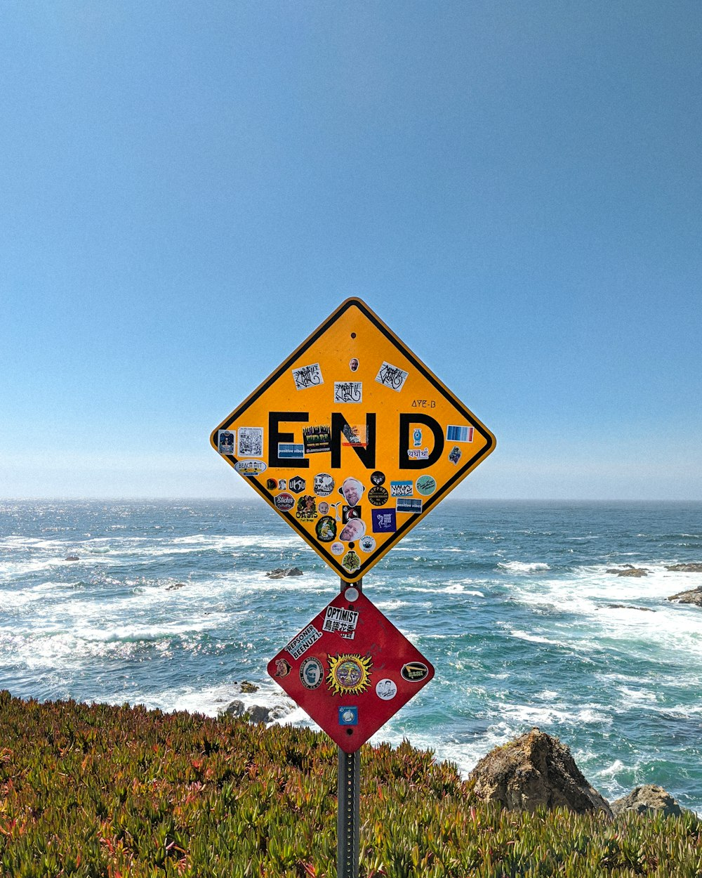
End of Python: Basics
Notes:
이상으로 ~에 대한 강의를 마치도록 하겠습니다.
감사합니다.

